Slide 1

Deep Neural Network
Module 3

Slide 2
Optimization

Slide 3
What we Learn….
3.1 Challenges in Neural Network Optimization – saddle points and plateau
3.2 Non-convex optimization intuition
3.3 Overview of optimization algorithms
3.4 Momentum based algorithms
3.5 Algorithms with Adaptive Learning Rates
Notes:
Talk about each topic in 1 or 2 sentences.

Slide 4
Optimization Algorithms

Slide 5
Optimization Algorithm
Optimization algorithms train deep learning models.
Optimization algorithms are the tools that allow
continue updating model parameters
to minimize the value of the loss function, as evaluated on the training set.
In optimization, a loss function is often referred to as the objective function of the optimization problem.
By tradition and convention most optimization algorithms are concerned with minimization.

Slide 6
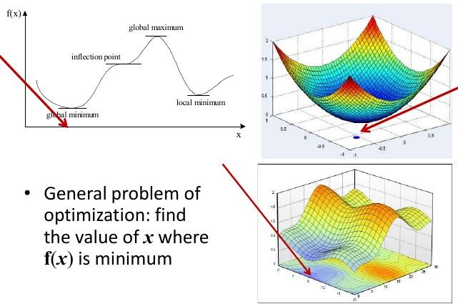
Optimization

Slide 7
Why Optimization Algorithm?
The performance of the optimization algorithm directly affects the modelʼs training efficiency.
Understanding the principles of different optimization algorithms and the role of their hyperparameters will enable us to tune the hyperparameters in a targeted manner to improve the performance of deep learning models.
The goal of optimization is to reduce the training error. The goal of deep learning is to reduce the generalization error, this requires reduction in overfitting also.

Slide 8
Optimization Challenges in Deep Learning
Local minima
Saddle points
Vanishing gradients

Slide 9
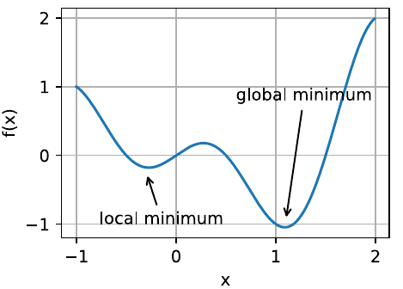
Local Minima
For any objective function f (x), if the value of f (x) at x is smaller than the values of f (x) at any other points in the vicinity of x, then f (x) could be a local minimum.
If the value of f (x) at x is the minimum of the objective function over the entire domain, then f (x) is the global minimum.
In minibatch stochastic gradient descent, the natural variation of gradients over minibatches is able to dislodge the parameters from local minima.

Slide 10
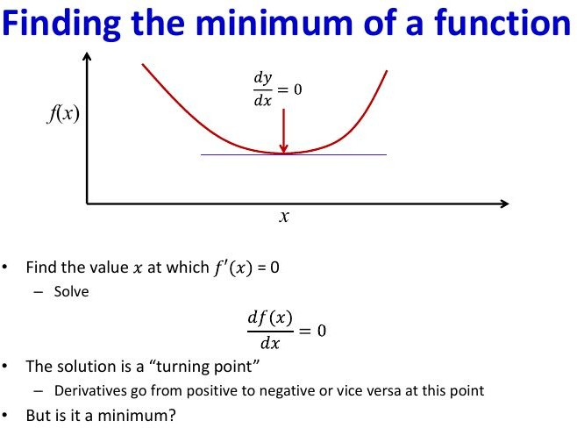
Finding Minimum of a Function

Slide 11
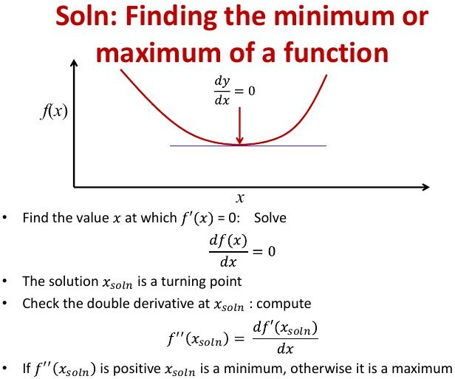
Finding Minimum of a Function

Slide 12
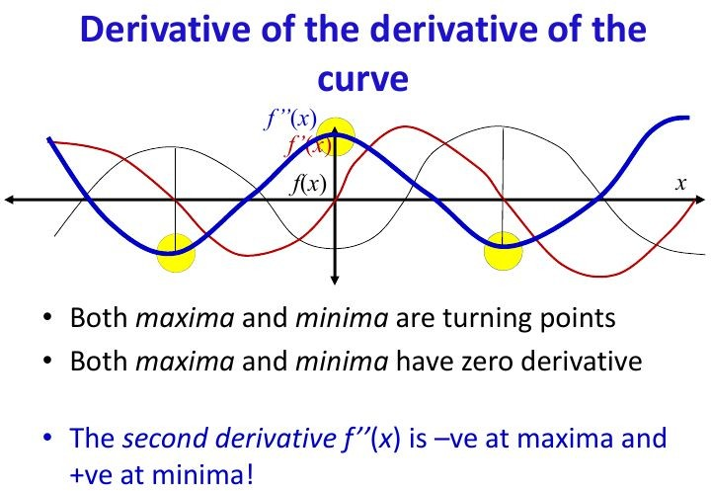
Derivatives of a Function

Slide 13
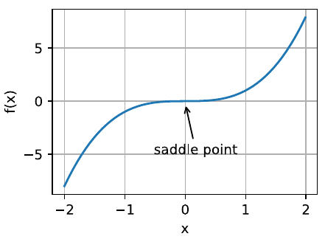
Saddle points
A saddle point is any location where all gradients of a function vanish but which is neither a global nor a local minimum.
Eg: f (x, y) = x^2 − y^2
saddle point at (0, 0)
Maximum wrt y
Minimum wrt x

Slide 14
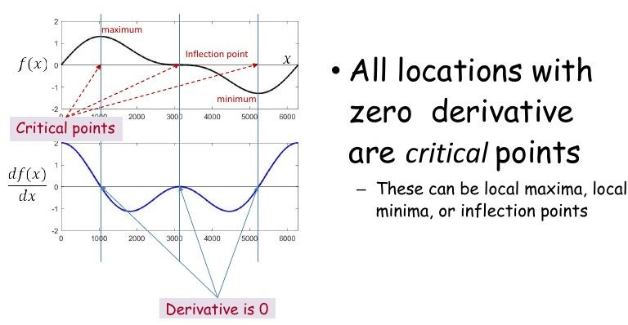
Derivatives at Saddle (Inflection) Point

Slide 15
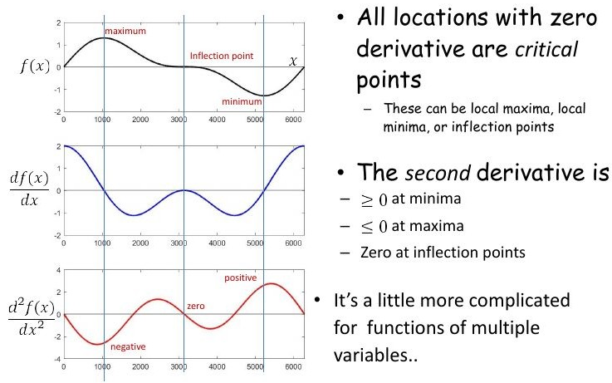
Derivatives at Saddle (Inflection) Point

Slide 16
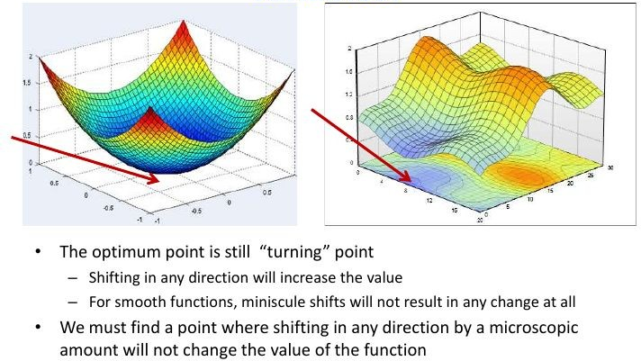
Functions of Multiple Variables

Slide 17
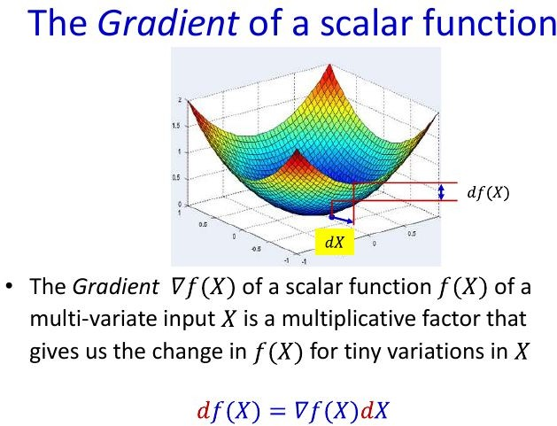
Gradient of a Scalar Function

Slide 18
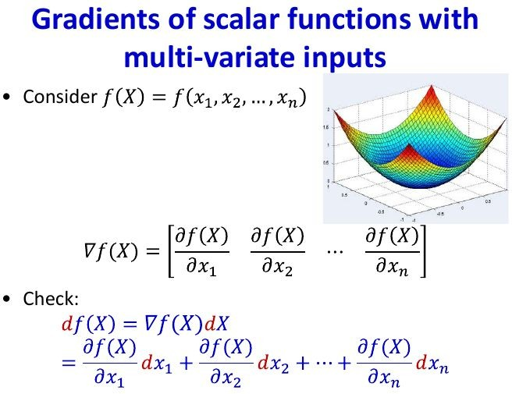
Gradient of a Scalar Function with multiple variables

Slide 19
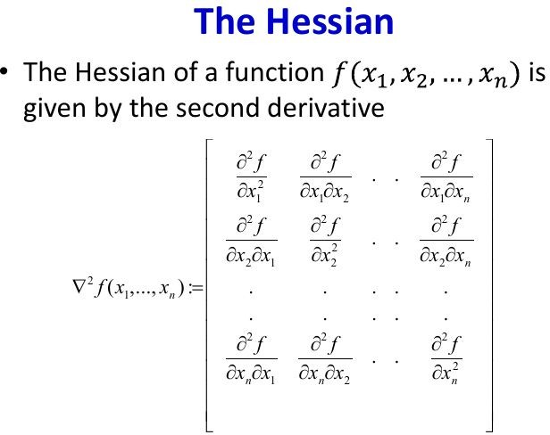
Hessian

Slide 20
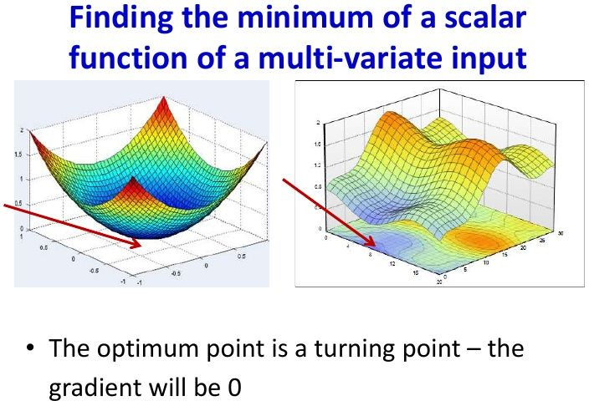
Gradient of a Scalar Function with multiple variables

Slide 21
Solution of Unconstrained Minimization
Solve for X where the gradient equation equal to zero.
⛛f(x) = 0
Compute the Hessian matrix ⛛²f(x) at the candidate solution and verify that
Local Minimum
Eigenvalues of Hessian matrix are all positive
Local Maximum
Eigenvalues of Hessian matrix are all negative
Saddle Point
Eigenvalues of Hessian matrix at the zero-gradient position are negative and positive

Slide 22
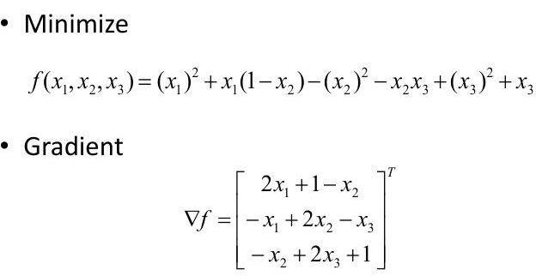
Example

Slide 23
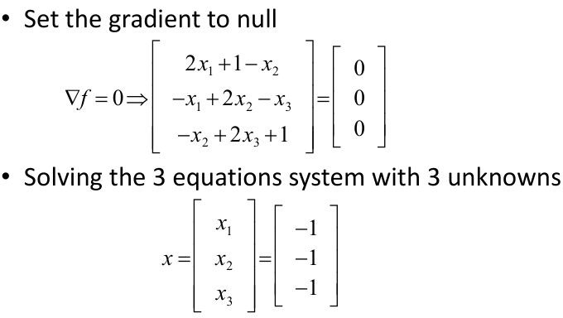
Example

Slide 24
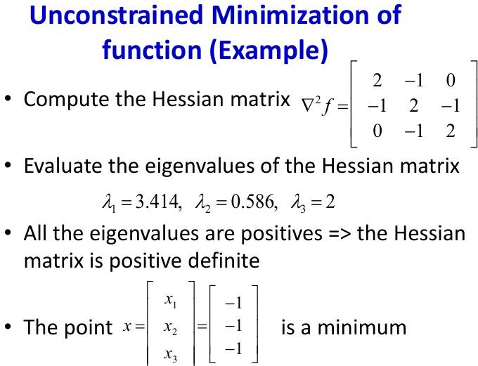
Example

Slide 25
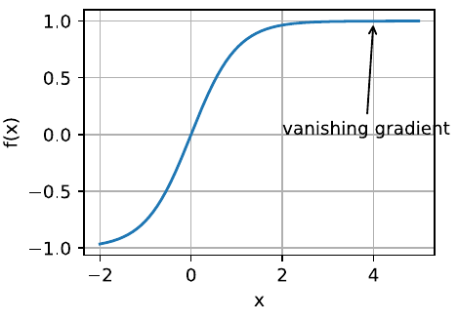
Vanishing gradients
Function f (x) = tanh(x)
f ′(x) = 1 − tanh²(x)
f ′(4) = 0.0013.
Gradient of f is close to nil.
Vanishing gradients can cause optimization to stall.
Reparameterization of the problem helps.
Good initialization of the parameters

Slide 26
Gradient Descent

Slide 27
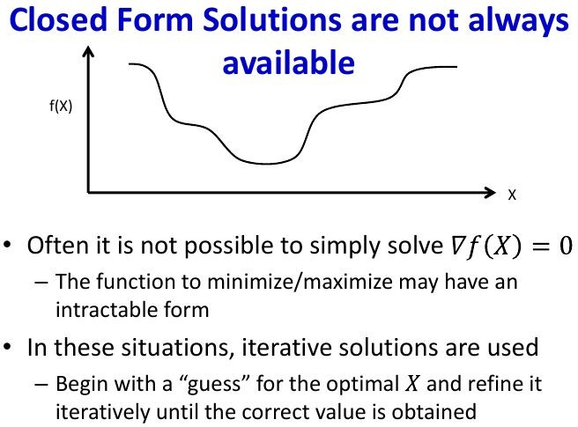
How to find Global Minima?

Slide 28
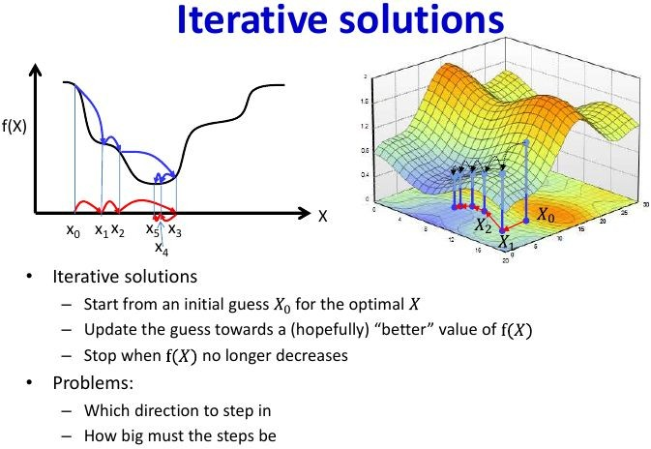
Find Global Minima Iteratively

Slide 29
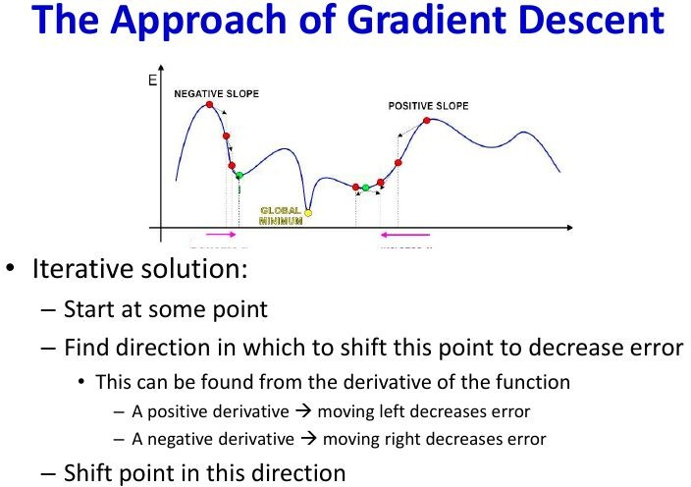
Approach of Gradient Descent

Slide 30
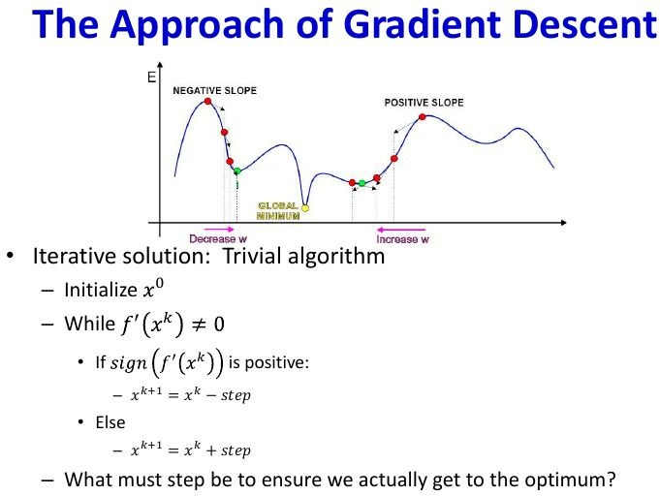
Approach of Gradient Descent

Slide 31
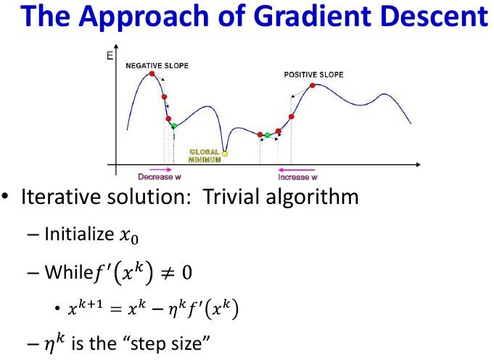
Approach of Gradient Descent
gd(eta, grad)
new = old - eta * grad

Slide 32
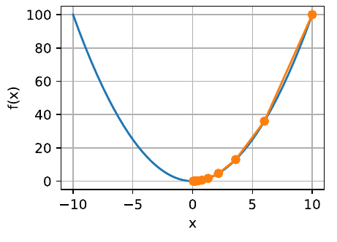
Approach of Gradient Descent
First order Gradient Descent algos consider the first order derivatives to get the value (magnitude) and direction of update.
gd(eta = 0.2, f_grad)
def gd(eta, f_grad):
x = 10.0
results = [x]
for i in range(10):
x -= eta * f_grad(x)
results.append(float(x))
return results

Slide 33
Effect of Learning Rate on Gradient Descent

Slide 34
Learning Rate
The role of the learning rate is to moderate the degree to which weights are changed at each step.
Learning rate η is set by the algorithm designer.
If the learning rate that is too small, it will cause x to update very slowly, requiring more iterations to get a better solution.
If the learning rate that is too large, the solution oscillates and in the worst case it might even diverge.

Slide 35
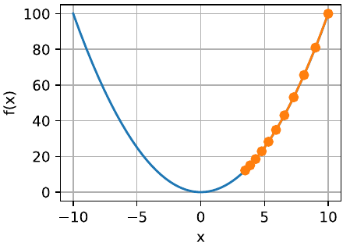
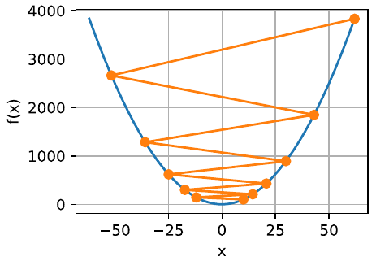
Learning rate and Gradient Descent
gd(eta = 0.05, f_grad)
gd(eta = 1.1, f_grad)
Slow Learning
If we pick eta too small, we make little progress.
Oscillations
If we pick eta too large, the solution oscillates and in the worst case it might diverge.

Slide 36
Stochastic Gradient Descent

Slide 37



Stochastic Gradient Descent
In deep learning, the objective function is the average of the loss functions for each example in the training dataset.
Given a training dataset of n examples, let f_{i} (x) is the loss function with respect to the training example of index i, where x is the parameter vector.
The objective function
The gradient of the objective function at x
Update x as
Computational cost of each iteration is O(1).

Slide 38
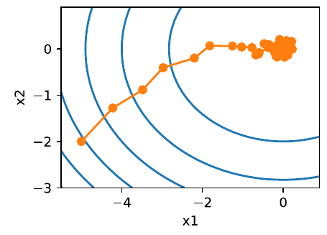
SGD with Constant Learning Rate
Trajectory of the variables in the stochastic gradient descent is much more noisy. This is due to the stochastic nature of the gradient. Even near the minimum, uncertainty is injected by the instantaneous gradient via η∇f_{i} (x).
def sgd(x1, x2, s1, s2, f_grad):
g1, g2 = f_grad(x1, x2)
# Simulate noisy gradient
g1 += np.random.normal(0.0, 1, (1,))
g2 += np.random.normal(0.0, 1, (1,))
eta_t = eta * lr()
return (x1 - eta_t * g1, x2 - eta_t * g2, 0, 0)

Slide 39
Dynamic Learning Rate

Slide 40
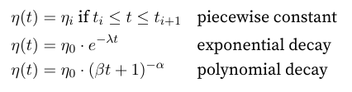
Dynamic Learning Rate
Replace η with a time-dependent learning rate η(t)
adds to the complexity of controlling convergence of an optimization algorithm.
A few basic strategies that adjust η over time.
Piecewise constant
decrease the learning rate, e.g., whenever progress in optimization stalls.
This is a common strategy for training deep networks. A
Exponential decay
Leads to premature stopping before the algorithm has converged.
Polynomial decay with α = 0.5.

Slide 41
Dynamic Learning Rate
Replace η with a time-dependent learning rate η(t)
adds to the complexity of controlling convergence of an optimization algorithm.
A few basic strategies that adjust η over time.

Slide 42
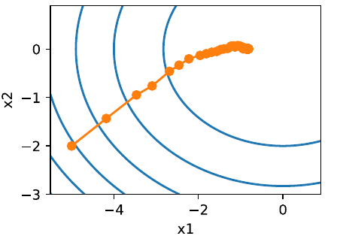
Exponential Decay
def exponential_lr():
global t
t += 1
return math.exp(-0.1 * t)
Variance in the parameters is significantly reduced.
The algorithm fails to converge at all.

Slide 43
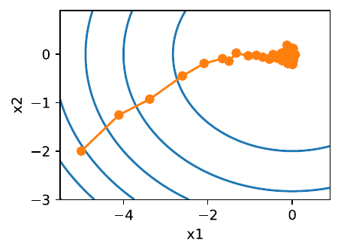
Polynomial decay
def polynomial_lr():
global t
t += 1
return (1 + 0.1 * t) ** (-0.5)
Use a polynomial decay
Learning rate decays with the inverse square root of the number of steps
Convergence gets better after only 50 steps.

Slide 44
Review
Gradient descent
Uses the full dataset to compute gradients and to update parameters, one pass at a time.
Gradient Descent is not particularly data efficient whenever data is very similar.
Stochastic Gradient descent
Processes one observation at a time to make progress.
Stochastic Gradient Descent is not particularly computationally efficient since CPUs and GPUs cannot exploit the full power of vectorization.
For noisy gradients, choice of the learning rate is critical.
If we decrease it too rapidly, convergence stalls.
If we are too lenient, we fail to converge to a good enough solution since noise keeps on driving us away from optimality.
MInibatch SGD
Accelerate computation, or better or computational efficiency.
Averaging gradients reduce the amount of variance.

Slide 45
Minibatch Stochastic Gradient Descent

Slide 46

Minibatch Stochastic Gradient Descent
In each iteration, we first randomly sample a minibatch B consisting of a fixed number of training examples.
We then compute the derivative (gradient) of the average loss on the minibatch with regard to the model parameters.
Finally, we multiply the gradient by a predetermined positive value η and subtract the resulting term from the current parameter values.
|B| represents the number of examples in each minibatch (the batch size) and η denotes the learning rate.
Notes:
use minibatches is computational efficiency.

Slide 47


Minibatch Stochastic Gradient Descent Algorithm
Gradients at time t is calculated as
|B| represents the number of examples in each minibatch (the batch size) and η denotes the learning rate.
is the stochastic gradient descent for sample i using the weights updated at time t − 1.
Notes:
use minibatches is computational efficiency.

Slide 48
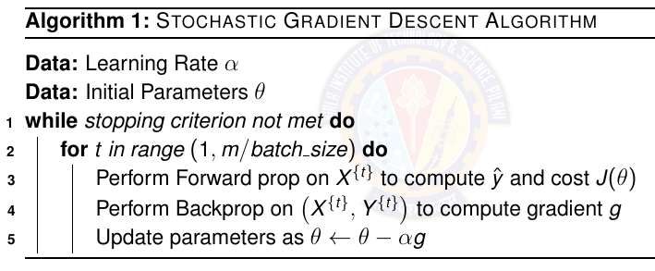
SGD Algorithm

Slide 49
Momentum

Slide 50

Leaky Average in Minibatch SGD
Replace the gradient computation by a “leaky average “ for better variance reduction. β ∈ (0, 1).
This effectively replaces the instantaneous gradient by one thatʼs been averaged over multiple past gradients.
v is called momentum. It accumulates past gradients.
Large β amounts to a long-range average and small β amounts to only a slight correction relative to a gradient method.
The new gradient replacement no longer points into the direction of steepest descent on a particular instance any longer but rather in the direction of a weighted average of past gradients.
Notes:
use minibatches is computational efficiency.

Slide 51
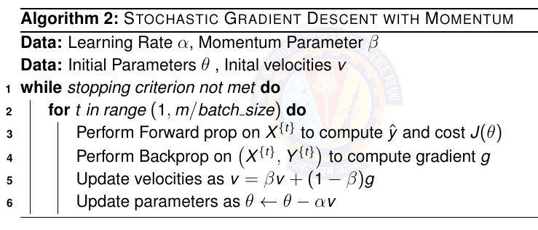
Momentum Algorithm

Slide 52

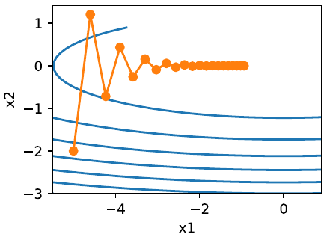
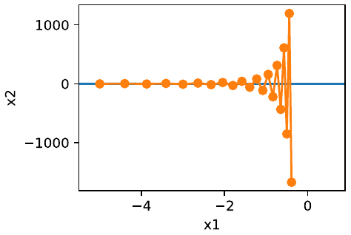
Momentum Method Example
Consider a moderately distorted ellipsoid objective
f has its minimum at (0, 0). This function is very flat in x1 direction.
For eta = 0.4. Without momentum
The gradient in the x2 direction oscillates than in the horizontal x1 direction.
For eta = 0.6. Without momentum
Convergence in the x1 direction improves but the overall solution quality is diverging.
Notes:
if we pick a small learning rate we ensure that the solution does not diverge in the x2 direction but we are saddled with slow convergence in the x1 direction. Conversely, with a large learning rate we progress rapidly in the x1 direction but diverge in x2 .

Slide 53
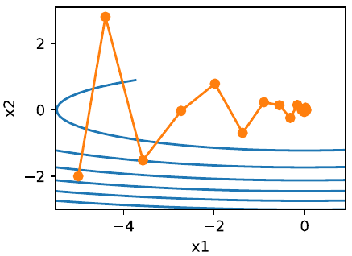
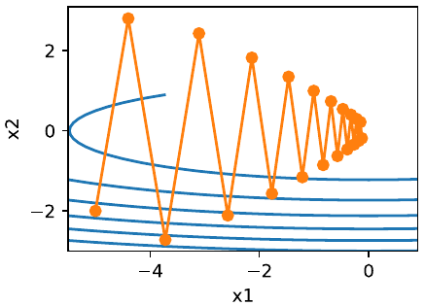
Momentum Method Example
Consider a moderately distorted ellipsoid objective
Apply momentum for eta = 0.6
For beta = 0.5.
Converges well. Lesser oscillations. Larger steps in x1 direction.
For beta = 0.25.
Reduced convergence. More oscillations. Larger magnitude of oscillations.

Slide 54
Momentum method: Summary
Momentum replaces gradients with a leaky average over past gradients. This accelerates convergence significantly.
Momentum prevents stalling of the optimization process that is much more likely to occur for stochastic gradient descent.
The effective number of gradients is given by 1/ (1−β ) due to exponentiated downweighting of past data.
Implementation is quite straightforward but it requires us to store an additional state vector (momentum v).

Slide 55
Adagrad

Slide 56
Adagrad
Used for features that occur infrequently (sparse features)
Adagrad uses aggregate of the squares of previously observed gradients.

Slide 57
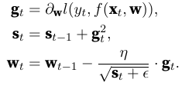
Adagrad Algorithm
Variable s_{t} to accumulate past gradient variance.
Operation are applied coordinate wise. √ (1 / v) has entries √( 1/ v_{i}) and u · v has entries u_{i} v_{i}. η is the learning rate and ε is an additive constant that ensures that we do not divide by 0.
Initialize s0 = 0.

Slide 58
Adagrad: Summary
Adagrad decreases the learning rate dynamically on a per-coordinate basis.
It uses the magnitude of the gradient as a means of adjusting how quickly progress is achieved - coordinates with large gradients are compensated with a smaller learning rate.
If the optimization problem has a rather uneven structure Adagrad can help mitigate the distortion.
Adagrad is particularly effective for sparse features where the learning rate needs to decrease more slowly for infrequently occurring terms.
On deep learning problems Adagrad can sometimes be too aggressive in reducing learning rates.

Slide 59
RMSProp

Slide 60
RMSProp
Adagrad use learning rate that decreases at a predefined schedule of effectively O(t^{− 1/2} ).
RMSProp algorithm decouples rate scheduling from coordinate-adaptive learning rates. This is essential for non-convex optimization.

Slide 61

RMSProp Algorithm
Use leaky average to accumulate past gradient variance.
Parameter gamma > 0.
The constant ε > 0 is set to 10⁻⁶ to ensure that we do not suffer from division by zero or overly large step sizes.

Slide 62
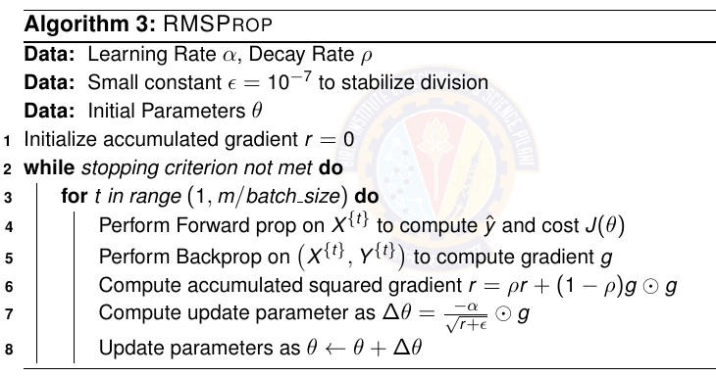
RMSProp Algorithm

Slide 63
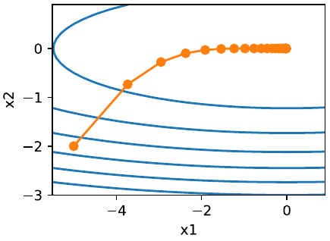
RMSProp Example
ef rmsprop_2d(x1, x2, s1, s2):
g1, g2, eps = 0.2 * x1, 4 * x2, 1e-6
s1 = gamma * s1 + (1 - gamma) * g1 ** 2
s2 = gamma * s2 + (1 - gamma) * g2 ** 2
x1 -= eta / math.sqrt(s1 + eps) * g1
x2 -= eta / math.sqrt(s2 + eps) * g2
return x1, x2, s1, s2

Slide 64
RMS Prop: Summary
RMSProp is very similar to Adagrad as both use the square of the gradient to scale coefficients.
RMSProp shares with momentum the leaky averaging. However, RMSProp uses the technique to adjust the coefficient-wise preconditioner.
The learning rate needs to be scheduled by the experimenter in practice.
The coefficient γ (gamma) determines how long the history is when adjusting the per-coordinate scale.

Slide 65
Adam

Slide 66
Review of techniques learned so far
Stochastic gradient descent
more effective than Gradient Descent when solving optimization problems, e.g., due to its inherent resilience to redundant data.
Minibatch Stochastic gradient descent
affords significant additional efficiency arising from vectorization, using larger sets of observations in one minibatch. This is the key to efficient multi-machine, multi-GPU and overall parallel processing.
Momentum
added a mechanism for aggregating a history of past gradients to accelerate convergence.
Adagrad
used per-coordinate scaling to allow for a computationally efficient preconditioner.
RMSProp
decoupled per-coordinate scaling from a learning rate adjustment.

Slide 67
Adam
Adam combines all these techniques into one efficient learning algorithm.
More robust and effective optimization algorithms to use in deep learning.
Adam can diverge due to poor variance control. (disadvantage)
Adam uses exponential weighted moving averages (also known as leaky averaging) to obtain an estimate of both the momentum and also the second moment of the gradient.

Slide 68


Adam Algorithm
State variables
β1 and β2 are nonnegative weighting parameters. Common choices for them are β1 = 0.9 and β2 = 0.999. That is, the variance estimate moves much more slowly than the momentum term.
Initialize v0 = s0 = 0
Normalize the state variables

Slide 69


Adam Algorithm
Rescale the gradient
Compute updates

Slide 70
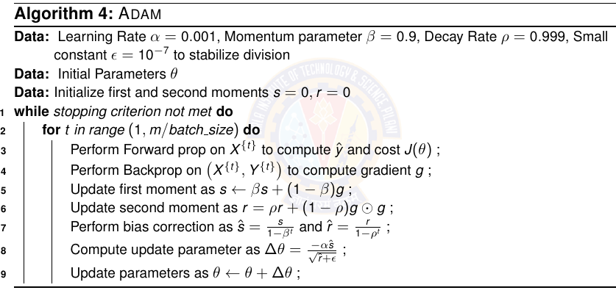
Adam Algorithm

Slide 71
Adam: Summary
Adam combines features of many optimization algorithms into a fairly robust update rule.
Adam uses bias correction to adjust for a slow startup when estimating momentum and a second moment.
For gradients with significant variance we may encounter issues with convergence. They can be amended by using larger minibatches or by switching to an improved estimate for state variables. Yogi algorithm offers such an alternative.

Slide 72
Learning Rate: Summary
Adjusting the learning rate is often just as important as the actual algorithm.
Magnitude of the learning rate matters. If it is too large, optimization diverges, if it is too small, it takes too long to train or we end up with a suboptimal result. Momentum algo helps.
The rate of decay is just as important. If the learning rate remains large we may simply end up bouncing around the minimum and thus not reach optimality. We want the rate to decay, but probably more slowly than O(t^{− 1/ 2} ) .
Initialization pertains both to how the parameters are set initially and also how they evolve initially. This is known as warmup, i.e., how rapidly we start moving towards the solution initially.

Slide 73
Numerical Problems

Slide 74
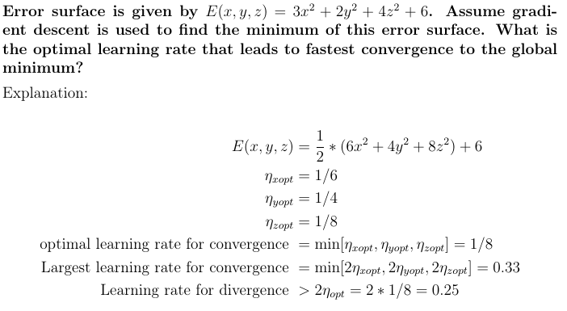
Question with Solution

Slide 75
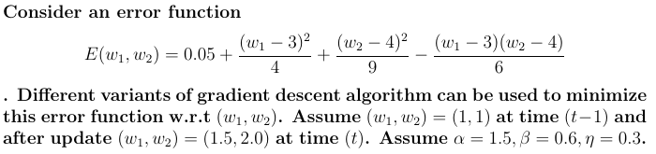
Question
Compute the value that minimizes (w1 , w2). Compute the minimum possible value of error.
What will be value of (w1 , w2 ) at time (t + 1) if standard gradient descent is used?
What will be value of (w1 , w2 ) at time (t + 1) if momentum is used?
What will be value of (w1 , w2 ) at time (t + 1) if RMSPRop is used?
What will be value of (w1 , w2 ) at time (t + 1) if Adam is used?

Slide 76
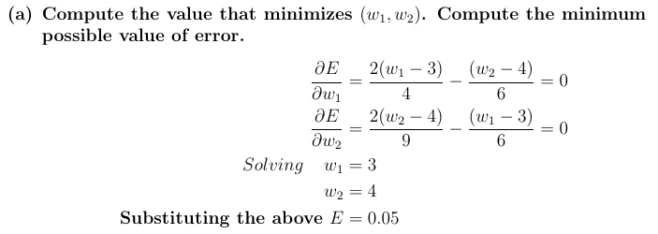
Solution

Slide 77
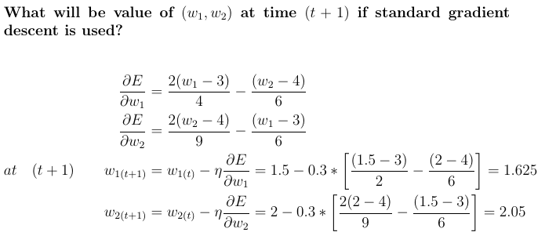
Solution

Slide 78
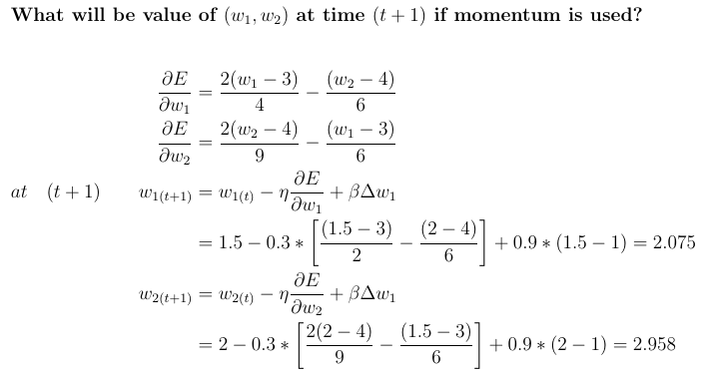
Solution

Slide 79
Ref TB Dive into Deep Learning
Chapter 12 (online version)

Slide 80
Next Session:
Regularization

